Slide 1
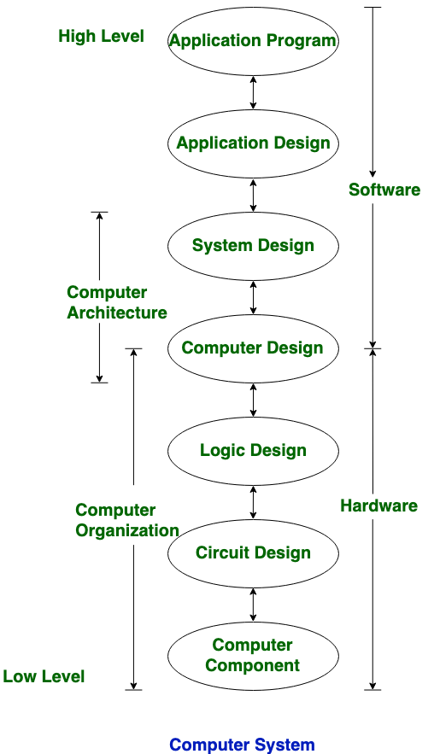

Slide 2
Computer Architecture | Computer Organization
Computer Architecture is concerned with the way hardware components are connected together to form a computer system. | Computer Organization is concerned with the structure and behaviour of a computer system as seen by the user.
It acts as the interface between hardware and software. | It deals with the components of a connection in a system.
Computer Architecture helps us to understand the functionalities of a system. | Computer Organization tells us how exactly all the units in the system are arranged and interconnected.
A programmer can view architecture in terms of instructions, addressing modes and registers. | Whereas Organization expresses the realization of architecture.
While designing a computer system architecture is considered first. | An organization is done on the basis of architecture.
Computer Architecture deals with high-level design issues. | Computer Organization deals with low-level design issues.
Architecture involves Logic (Instruction sets, Addressing modes, Data types, Cache optimization) | Organization involves Physical Components (Circuit design, Adders, Signals, Peripherals)

Slide 3
The Von Neumann Model

Slide 4
The Stored Program Computer
1943: ENIAC
  Presper Eckert and John Mauchly -- first general electronic computer.
  (or was it John V. Atanasoff in 1939?)
  Hard-wired program -- settings of dials and switches.
1944: Beginnings of EDVAC
  among other improvements, includes program stored in memory
1945: John von Neumann
  wrote a report on the stored program concept,
  known as the First Draft of a Report on EDVAC
The basic structure proposed in the draft became known
as the “von Neumann machine” (or model).
  a memory, containing instructions and data
  a processing unit, for performing arithmetic and logical operations
  a control unit, for interpreting instructions
For more history, see http://www.maxmon.com/history.htm

Slide 5
Von Neumann Model

Slide 6
Memory
2^{k} x m array of stored bits
Address
  unique (k-bit) identifier of location
Contents
  m-bit value stored in location
Basic Operations:
LOAD
  read a value from a memory location
STORE
  write a value to a memory location
0000
0001
0010
0011
0100
0101
0110
1101
1110
1111
00101101
•
•
•
10100010

Slide 7
Interface to Memory
How does processing unit get data to/from memory?
MAR: Memory Address Register
MDR: Memory Data Register
To LOAD a location (A):
  Write the address (A) into the MAR.
  Send a “read” signal to the memory.
  Read the data from MDR.
To STORE a value (X) to a location (A):
  Write the data (X) to the MDR.
  Write the address (A) into the MAR.
  Send a “write” signal to the memory.

Slide 8
Processing Unit
Functional Units
  ALU = Arithmetic and Logic Unit
  could have many functional units.
  some of them special-purpose
  (multiply, square root, …)
  LC-3 performs ADD, AND, NOT
Registers
  Small, temporary storage
  Operands and results of functional units
  LC-3 has eight registers (R0, …, R7), each 16 bits wide
Word Size
  number of bits normally processed by ALU in one instruction
  also width of registers
  LC-3 is 16 bits

Slide 9
Input and Output
Devices for getting data into and out of computer memory
Each device has its own interface,
usually a set of registers like the
memory’s MAR and MDR
  LC-3 supports keyboard (input) and monitor (output)
  keyboard: data register (KBDR) and status register (KBSR)
  monitor: data register (DDR) and status register (DSR)
Some devices provide both input and output
  disk, network
Program that controls access to a device is
usually called a driver.

Slide 10
Control Unit
Orchestrates execution of the program
Instruction Register (IR) contains the current instruction.
Program Counter (PC) contains the address
of the next instruction to be executed.
Control unit:
  reads an instruction from memory
    the instruction’s address is in the PC
  interprets the instruction, generating signals
  that tell the other components what to do
    an instruction may take many machine cycles to complete

Slide 11
Instruction Processing
Fetch instruction from memory
Decode instruction
Evaluate address
Fetch operands from memory
Execute operation
Store result

Slide 12
Instruction
The instruction is the fundamental unit of work.
Specifies two things:
  opcode: operation to be performed
  operands: data/locations to be used for operation
An instruction is encoded as a sequence of bits.
(Just like data!)
  Often, but not always, instructions have a fixed length,
  such as 16 or 32 bits.
  Control unit interprets instruction:
  generates sequence of control signals to carry out operation.
  Operation is either executed completely, or not at all.
A computer’s instructions and their formats is known as its
Instruction Set Architecture (ISA).

Slide 13
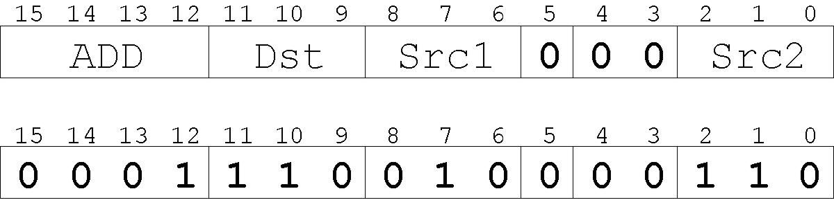
Example: LC-3 ADD Instruction
LC-3 has 16-bit instructions.
  Each instruction has a four-bit opcode, bits [15:12].
LC-3 has eight registers (R0-R7) for temporary storage.
  Sources and destination of ADD are registers.
“Add the contents of R2 to the contents of R6,
and store the result in R6.”

Slide 14
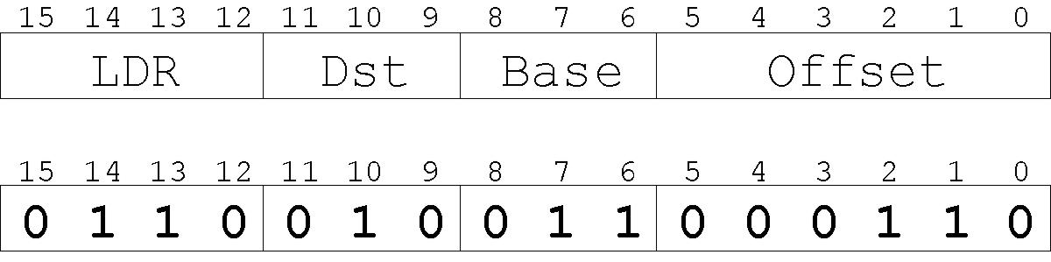
Example: LC-3 LDR Instruction
Load instruction -- reads data from memory
Base + offset mode:
  add offset to base register -- result is memory address
  load from memory address into destination register
“Add the value 6 to the contents of R3 to form a
memory address. Load the contents of that
memory location to R2.”

Slide 15
Instruction Processing: FETCH
F
Load next instruction (at address stored in PC)
from memory
into Instruction Register (IR).
  Copy contents of PC into MAR.
  Send “read” signal to memory.
  Copy contents of MDR into IR.
Then increment PC, so that it points to
the next instruction in sequence.
  PC becomes PC+1.
D
EA
OP
EX
S

Slide 16
Instruction Processing: DECODE
F
First identify the opcode.
  In LC-3, this is always the first four bits of instruction.
  A 4-to-16 decoder asserts a control line corresponding
  to the desired opcode.
Depending on opcode, identify other operands
from the remaining bits.
  Example:
    for LDR, last six bits is offset
    for ADD, last three bits is source operand #2
D
EA
OP
EX
S

Slide 17
Instruction Processing: EVALUATE ADDRESS
F
For instructions that require memory access,
compute address used for access.
Examples:
  add offset to base register (as in LDR)
  add offset to PC
  add offset to zero
D
EA
OP
EX
S

Slide 18
Instruction Processing: FETCH OPERANDS
F
Obtain source operands needed to
perform operation.
Examples:
  load data from memory (LDR)
  read data from register file (ADD)
D
EA
OP
EX
S

Slide 19
Instruction Processing: EXECUTE
F
Perform the operation,
using the source operands.
Examples:
  send operands to ALU and assert ADD signal
  do nothing (e.g., for loads and stores)
D
EA
OP
EX
S

Slide 20
Instruction Processing: STORE RESULT
F
Write results to destination.
(register or memory)
Examples:
  result of ADD is placed in destination register
  result of memory load is placed in destination register
  for store instruction, data is stored to memory
    write address to MAR, data to MDR
    assert WRITE signal to memory
D
EA
OP
EX
S

Slide 21
8086 architecture
https://slideplayer.com/slide/10604519/

Slide 22
8086 has two operating Modes:
Minimum mode
Maximum mode

Slide 23
Minimum mode:
In this 8086 is the only processor in the system . In a minimum mode 8086 system.
8086 is operated in minimum mode when MN/MX’ pin to logic 1.
In this mode, all the control signals are given out by the 8086 itself.

Slide 24
Maximum mode:
In this we can connect more processors to 8086 (8087/8089).
8086 max mode is basically for implementation of allocation of global resources and passing bus control to other coprocessor(i.e. second processor in the system), because two processors can not access system bus at same instant.
All processors execute their own program.
The resources which are common to all processors are known as global resources.
The resources which are allocated to a particular processor are known as local or private resources.

Slide 25
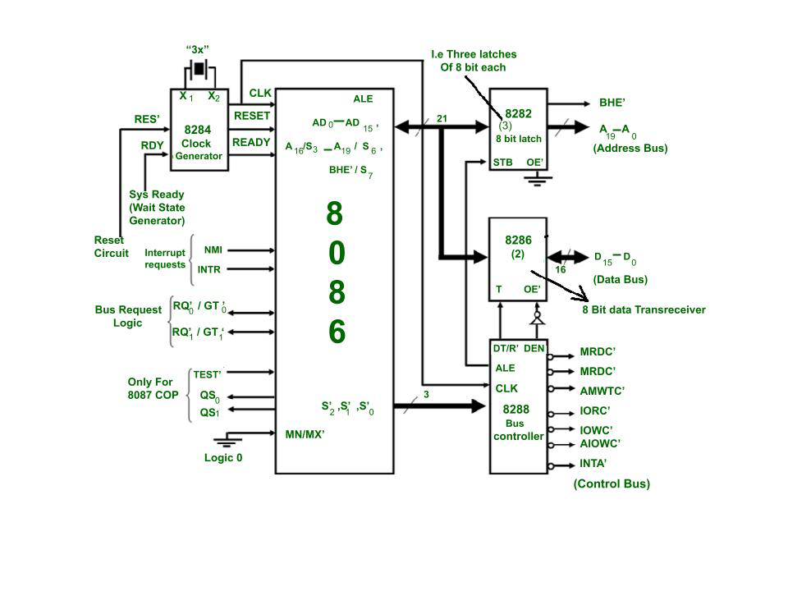

Slide 26
advantage
It helps to interface more devices like 8087.This interface is also called a closely coupled co-Processor configuration. In this 8086 is called as the host and 8087 as Co-processor.
It supports multiprocessing, Therefore it helps to increase the efficiency.
The 8087 was the first floating-point coprocessor for the 8086 series of microprocessors. The purpose of the 8087 was to increase calculations for floating point operations, such as add, sub, multiply, divide, and square root.

Slide 27
Applications of 8086:
Microcomputer are built using 8086. For example : IBM PC, used the Intel 8088, a version of the 8086 with 8-bit data bus.
It is used in calculators.
It is used for control purposes like in traffic signals(uses micro controllers which are nothing but contains one or more CPUs along with memory and programmable i/o peripherals).

Slide 28
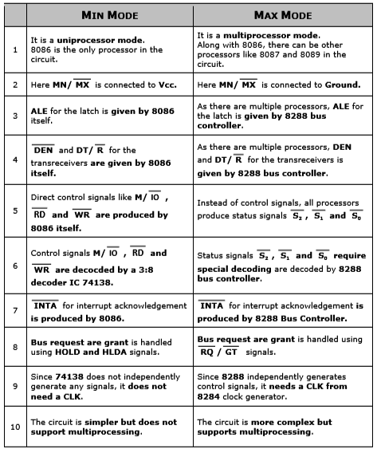

Slide 29
Addressing mode 8086
https://slideplayer.com/slide/13809916/

Slide 30
https://www.righto.com/2020/07/the-intel-8086-processors-registers.html

